Slide 1
Employee Turnover
Michelle Rice
DSC530

Slide 2
Dataset
The data for this study was retrieved from:
https://www.kaggle.com/chandrilcg/hr-analytics-employee-turnover
Variables in the dataset:
Satisfaction Level Last evaluation Number of projects Average monthly hours Time spent at company | Work accident Left Promotion last 5 years Department Salary

Slide 3
Dataset
Variables selected to use:
Satisfaction Level: this is a numeric rating from 0-1. I would expect that lower satisfaction levels would lead to more turnover, but I will attempt to prove that and then explore this variable as it relates to the other variables looking at correlation or covariance and possibly partial correlation between multiple variables.
Average monthly hours worked: this is a straight forward variable given in hours.
Time Spent with Company: this is also a straightforward variable given in years.
Left the company: this is a nominal variable where 1=yes and 0=no
Promotion in the last five years: this is a nominal variable where 1=yes and 0=no
Department: this is a basic categorical variable
Salary: this is broken down to three categories of low, medium and high, however we do not know what the actual values are within those categories

Slide 4
Purpose of the study
By analyzing this dataset, I will attempt to answer the following questions regarding employee satisfaction and turnover:
Can we predict that employees will leave based on them reaching or falling below a certain satisfaction level?
How do salary, promotions and monthly hours correlate to satisfaction?
Are employees with higher salary levels less likely to leave even if they have a low satisfaction level?
Is there an average time with the company that employees tend to leave, and is there a length of time beyond which they are unlikely to leave even if they are not satisfied?
Do certain departments experience higher turnover regardless of employee satisfaction?

Slide 5
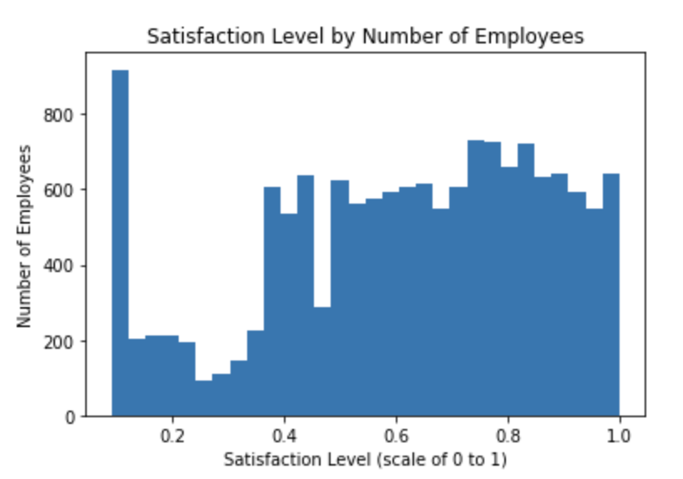
Satisfaction Level
This histogram shows the satisfaction level rating by number of employees. There is a large number of employees that rated their satisfaction VERY low, but then after that, the number of low ratings drops significantly and then drops again for it’s lowest count around a rating just over .2. There is a significant increase in ratings around .4 with one interesting dip around 4.5 before it goes back up and somewhat levels off.
The mean satisfaction level is 0.613 with a standard deviation of 0.249

Slide 6
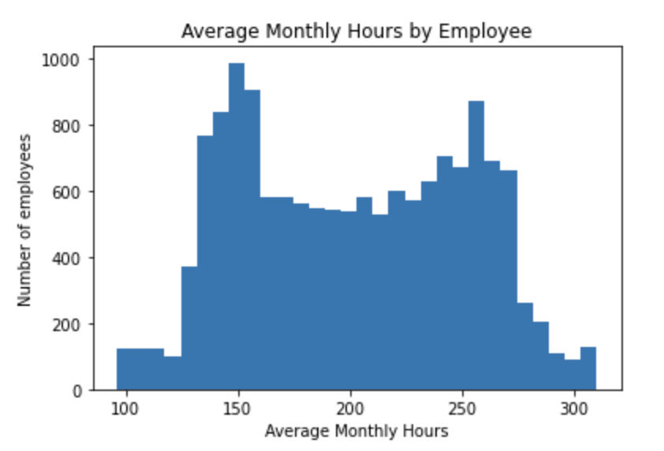
Average Monthly Hours
The plot of average monthly hours per employee appears to have some significant outliers working well below or above most other employees. The peak number of employees is working around 150 hours, which would be expected for full time employees, a fairly significant amount are working 150 to 250 hours with one additional peak around 260. But there are employees working as little as 100 and as much as over 300 hours. It’s difficult to determine if the lower values are really outliers since we don’t know if they could be part time employees or if there is some other reason for them to be not working. However, I think looking at that upper end could potentially provide some insight since that is not a typical amount of hours.
Mean = 201.05
Std deviation = 49.943

Slide 7
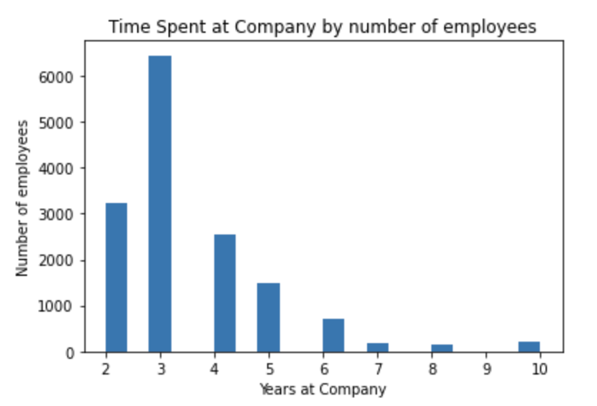
Time with Company
Mean time with the company is 3.498 with a standard deviation of 1.46. The distribution has a tail to the right indicating that there are some outliers with more years of service. I don’t think this is particularly significant as this is a normal trend in most workplaces, however, I am interested in those outliers since one of my questions was to look at whether long term employees are more likely to stay even if they have a low satisfaction level.

Slide 8
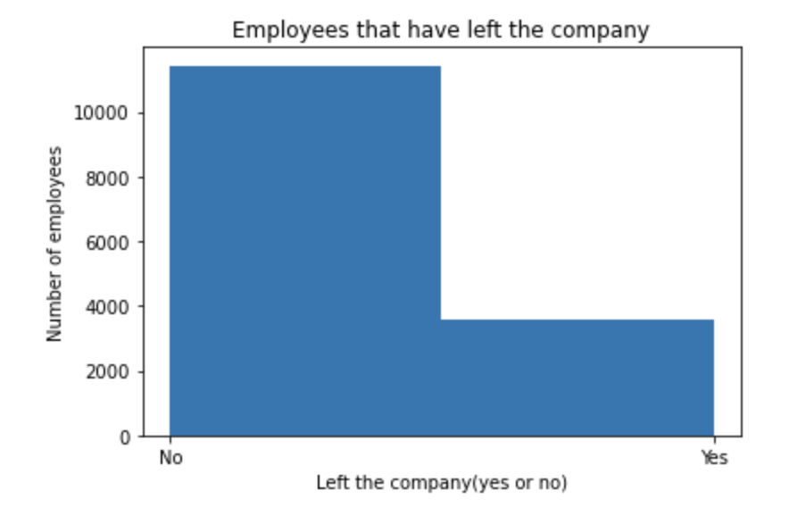
Employees who left the company
Number of employees who are still with the company compared to those who have left. This doesn’t really show us anything unusual. The mean, which in this case equals the percent of employees that have left, is .238, which is pretty close to the national average of turnover in 2020. I would like to use this variable primarily to gather information about employees that left, such as satisfaction level.

Slide 9
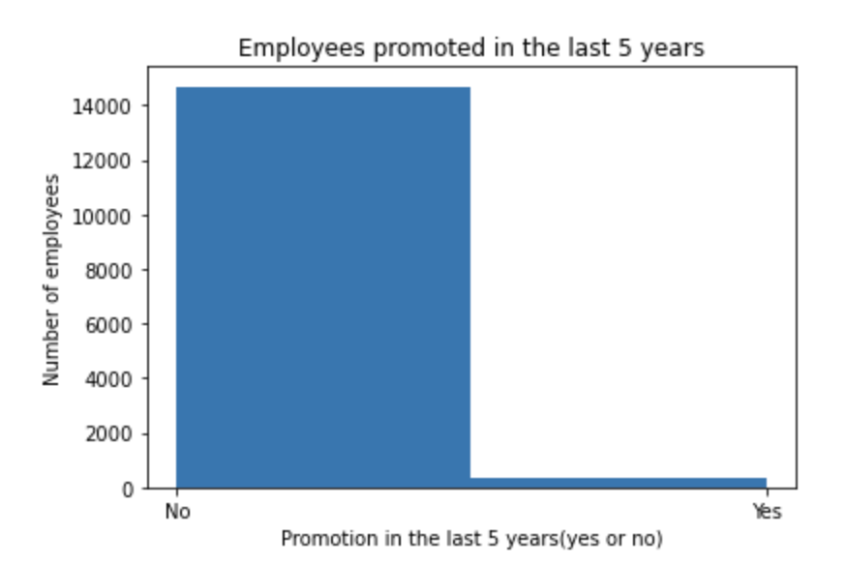
Employees promoted in last 5 years
The number of employees promoted in the last 5 years seems to be very low. Doing a count on this variable shows that only 319 of the 14, 999 employees included in the data had been promoted.

Slide 10
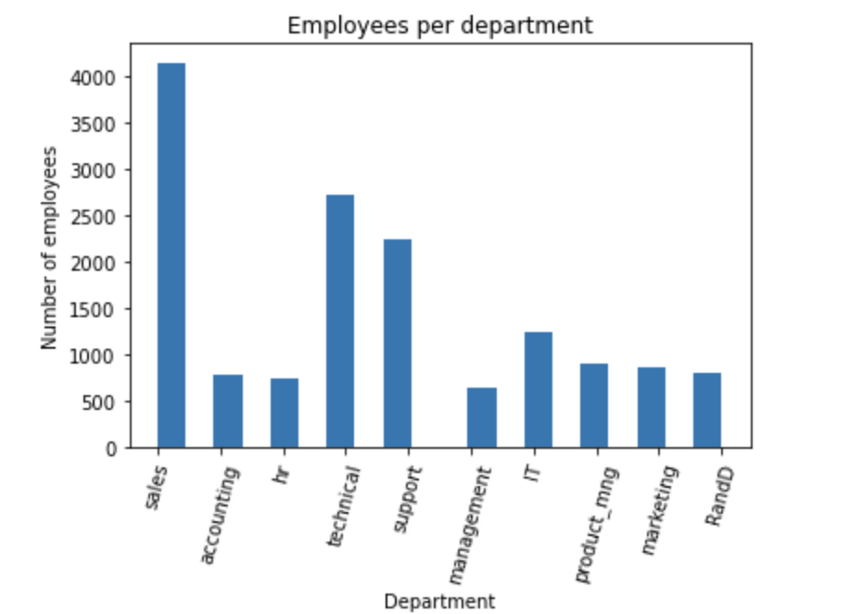
Employees by Department
This chart shows the distribution of employees per department. I will use this to compare satisfaction level of employees and employees leaving per department to see if there are any trends with certain departments having more turnover or unsatisfied employees.
Department counts:
sales 4140 | marketing 858
technical 2720 | RandD 787
support 2229 | accounting 767
IT 1227 | hr 739
product_mng 902 | management 630

Slide 11
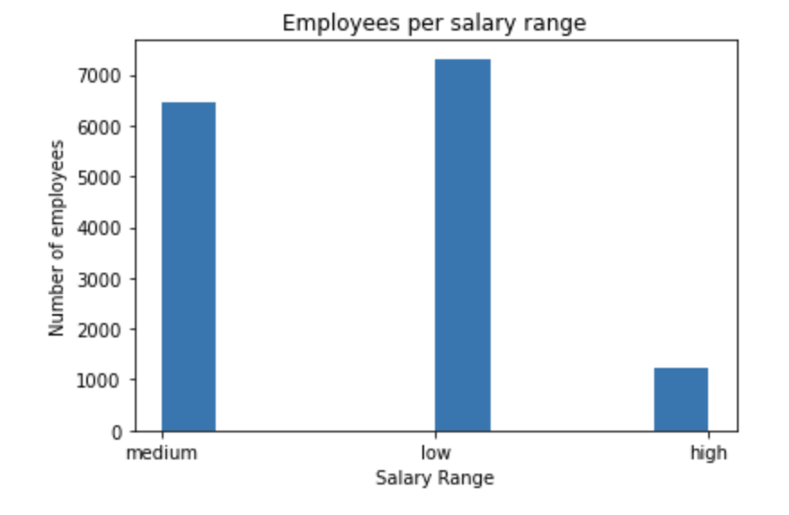
Employees per salary range
I don’t see anything unusual with the salary distribution, with most employees being in the low and medium range and a much smaller amount of high range. It’s difficult to draw much conclusions from this without knowing exactly what the ranges are, how wide the ranges themselves are and what the distribution is within them, and how much difference there is between the low and high end. I would, however, like to see if higher salary correlates to higher satisfaction and staying with the company.

Slide 12
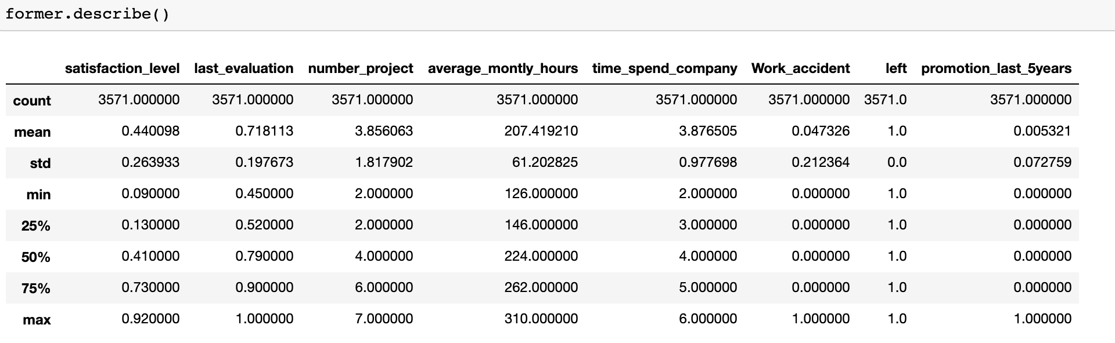
Describe former employees
In order to get a look at how employees who have left the company rated in other categories, I performed a describe() on both groups. This table shows us former employees:

Slide 13
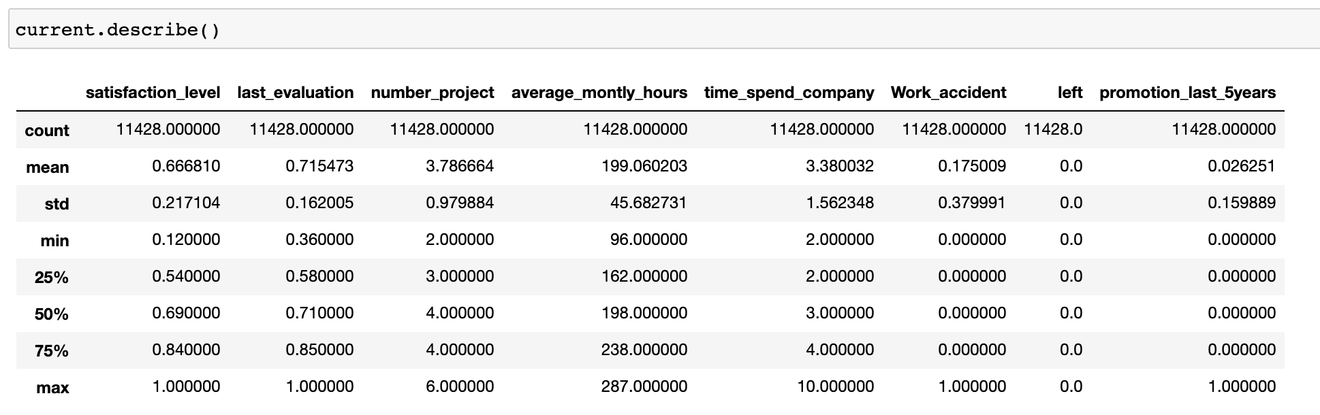
Describe current employees
The table for current employees:

Slide 14
Describe, cont.
Looking at these stats can help us answer the first question: Can we predict that employees will leave based on them reaching or falling below a certain satisfaction level?
The mean satisfaction level for employees who leave is .44 with the 50th percentile being .41. The 25th percentile drops to a satisfaction level of .13 and the min is .09. Comparatively, the mean for current employees was .67, with the 50th percentile at .69 and the 25th percentile at .54. From this I would deduce that once employees drop below .4 the likelihood of them leaving goes up and once they get to .10 or below, it is very likely that they will leave.

Slide 15
Describe, cont.
From the describe data we can also take a look at the first part of question 4: Is there an average time with the company that employees tend to leave?
The mean time that former employees were at the company was 3.88 years. For current employees the mean is 3.38 years. For employees who had left, the 75th percentile was 5 years, for current employees it is 4 years. So, It appears that we can assume that somewhere around 4-5 years is a common time for employees to leave the company.

Slide 16
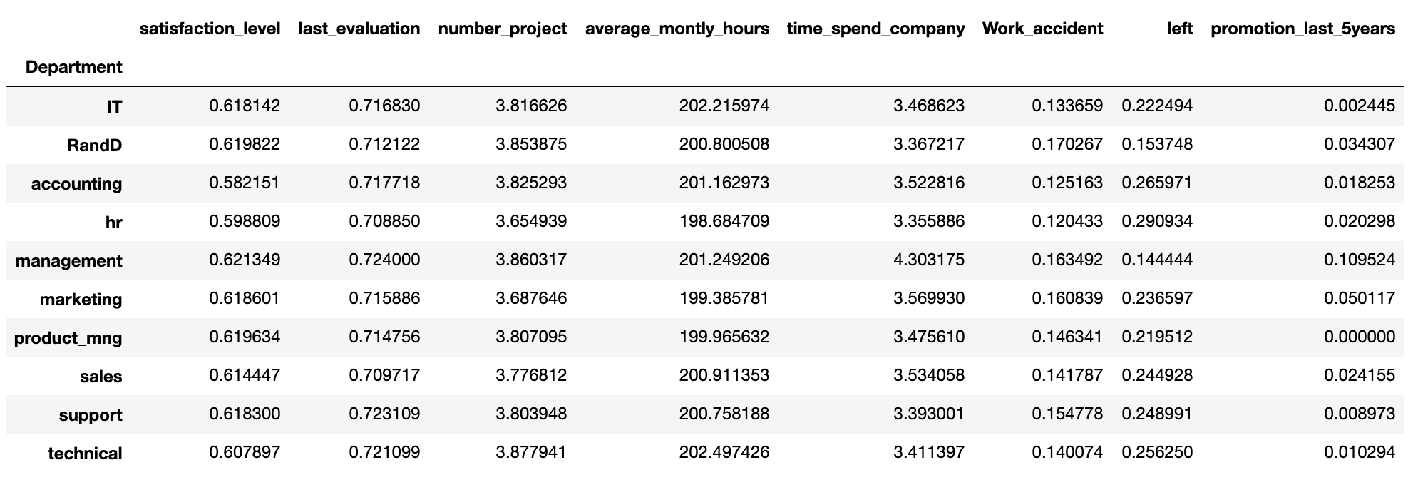
Department describe
In order to analyze departments, I also did a describe by department. Based on this, I cannot see any obvious differences by department. Management has a slightly lower turnover and slightly longer time with company and very slightly higher satisfaction level, but nothing that I see as significant:

Slide 17
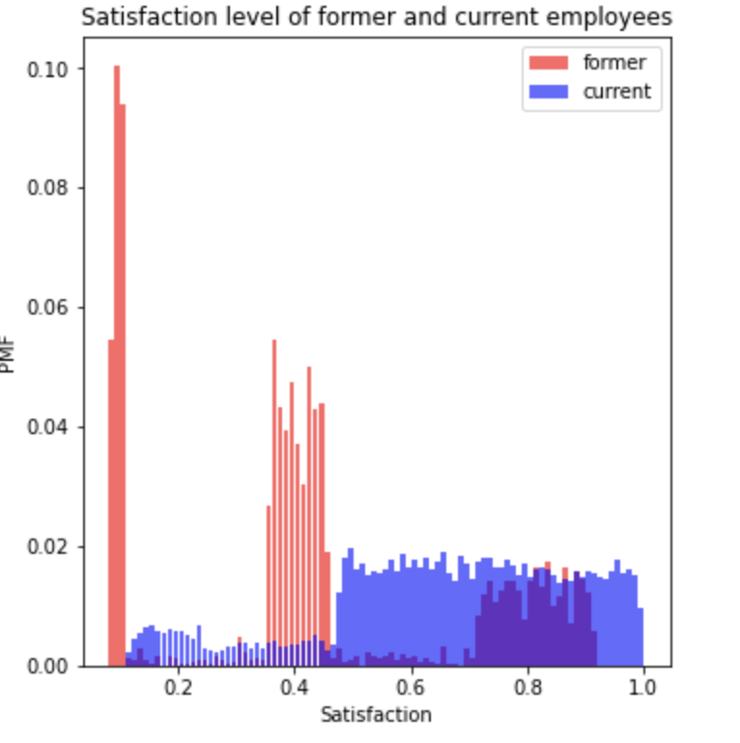
Satisfaction level of former and current employees (PMF)
By creating a PMF on the satisfaction variable for both current and former employees, we can see that there does appear to be a relationship between an employee being dissatisfied and leaving the company. We see a huge spike in very low satisfaction among former employees, another cluster around a .4 level of satisfaction and while there are some former employees between .7-.9, we don’t see any from about .9-1. For current employees, however, there is less distribution at the far lower end and in general a low distribution below .5, then a steady distribution all the way from .5-1. This supports my theory from the describe data that .4 would be a level that employees would be more likely to leave. It is also noteable that for current employees we can see that the distribution is significantly above that .4 level.

Slide 18
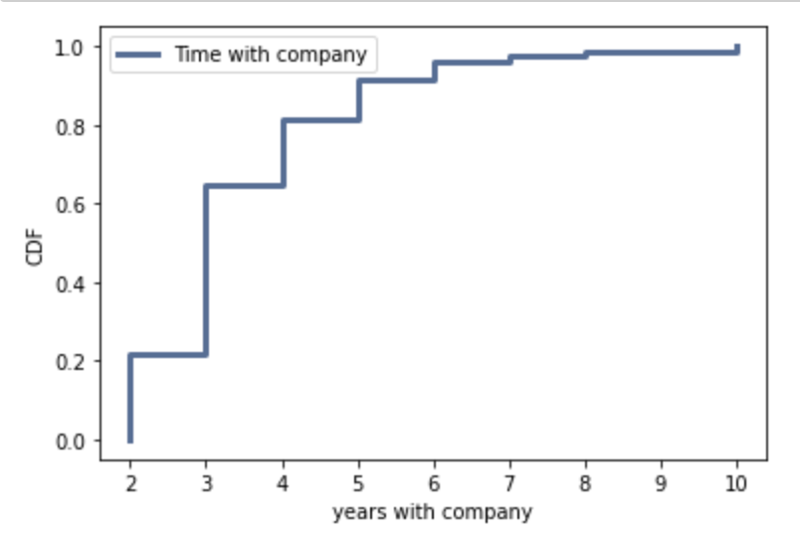
Cumulative Distribution of Time with Company
Plotting a CDF of time with the company shows us the cumulative probability of staying with the company for x number of years. Based on the graph, the probability of an employee staying for 3 years or less is about 20%, 5 years or less jumps to about 80% and by 10 years there is close to a 100% chance that an employee will stay for 10 years or less. Recall that the mean time with the company is 3.498 with a standard deviation of 1.46. In Jan. 2020 the median tenure in the US was 4.1 yeas, so this company appears to be slightly below that but this does not seem to be too unusual.

Slide 19
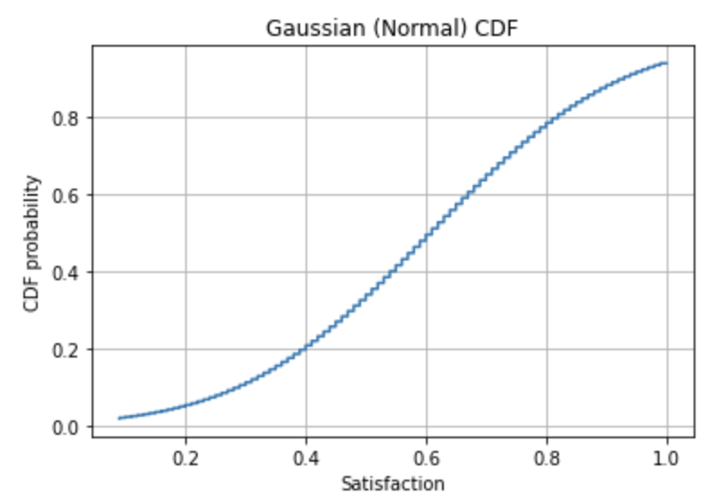
Gaussian (Normal) CDF plot
Using mu = .613 and sigma = .249 in the EvalNormalCdf function we can see that this distribution has only a very slight sigmoid shape, staying very near a straight line, indicating that this is a normal distribution.

Slide 20
Factors in Satisfaction Level
Question 2 asked: How do salary, promotions and monthly hours correlate to satisfaction?
Looking at a scatterplot of hours vs. satisfaction level shows a very wide range of values with no strong correlation, but we do see a few things. We can see a cluster in low satisfaction level once average hours gets about about 250.
We also see some heavier saturation around 150 hours and satisfaction level of .4. If we look back at the histograms for those two variables, we also saw spikes in the number of responses around those levels, so this could be a result of just having more results in both of those points and not necessarily causation.

Slide 21
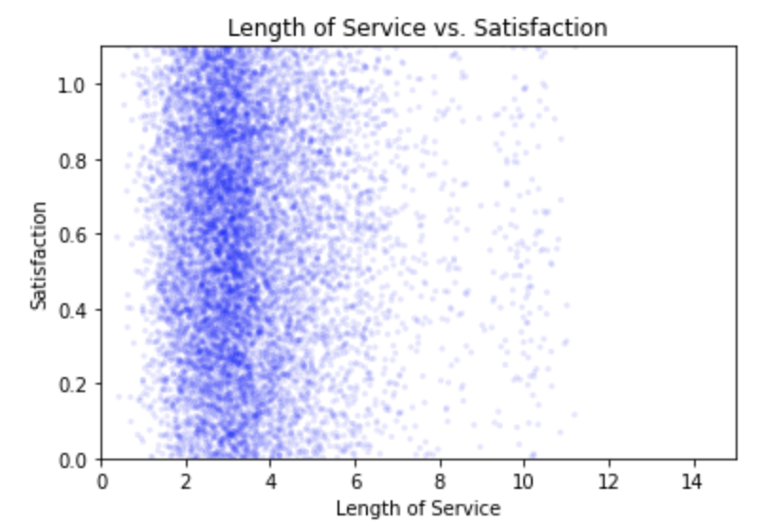
Factors in Satisfaction Level, cont.
Plotting length of service against satisfaction level, we see very heavy saturation of data around 3-4 years, which is indicative of the previous findings that the mean time at the company is around 3.8 years. It is very difficult to see any correlation between length of service and satisfaction level based on the distribution of this plot.

Slide 22
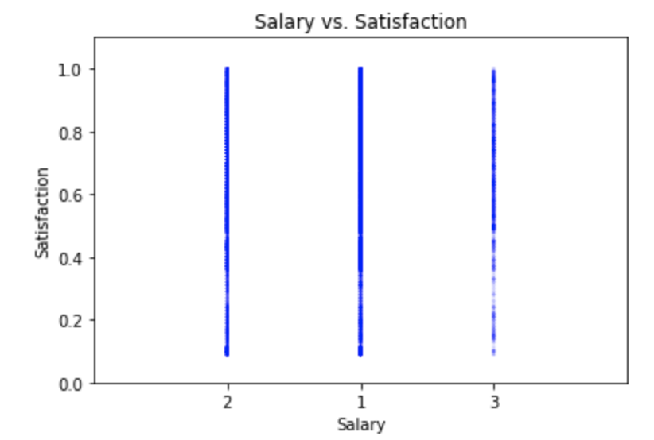
Factors in Satisfaction Level, cont.
I attempted to plot salary level against satisfaction level. In order to do so, I replaced the labels of low, medium and high with numeric values of 1, 2 and 3.
I am unsure of why they were ordered as they are on the x axis and once again we see pretty well distributed responses across all satisfaction levels and a very saturated plot.
The one exception is that we do see less saturation in salary level 3 (high) at the low satisfaction level, indicating that there could be some correlation to higher pay and higher satisfaction.

Slide 23
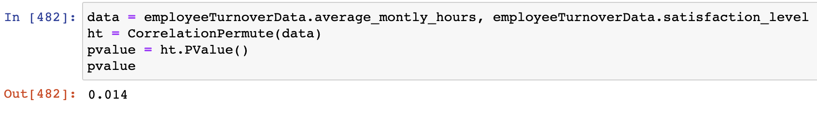
Correlation Test
Our data has shown that, as expected, satisfaction level is a key predictor of employee turnover, but I still want to explore which factors lead to low satisfaction levels. One hypothesis is that overworked employees, or those working too many hours, would be less satisfied. In order to test this, I did a Correlation Permutation test between average hours worked and satisfaction level.
This test returned a p-value of .014, indicating that there is a correlation between these two variables.

Slide 24
Regression Analysis
In order to determine what variables can predict an employee leaving the company, I performed a logistic regression using ‘left’ as the dependent variable and satisfaction level, time at company and salary as predictor variables:
The results (on the next slide) show that all of the predictor variables have a p-value near zero, indicating that they are all significant predictors of an employee leaving the company.

Slide 25
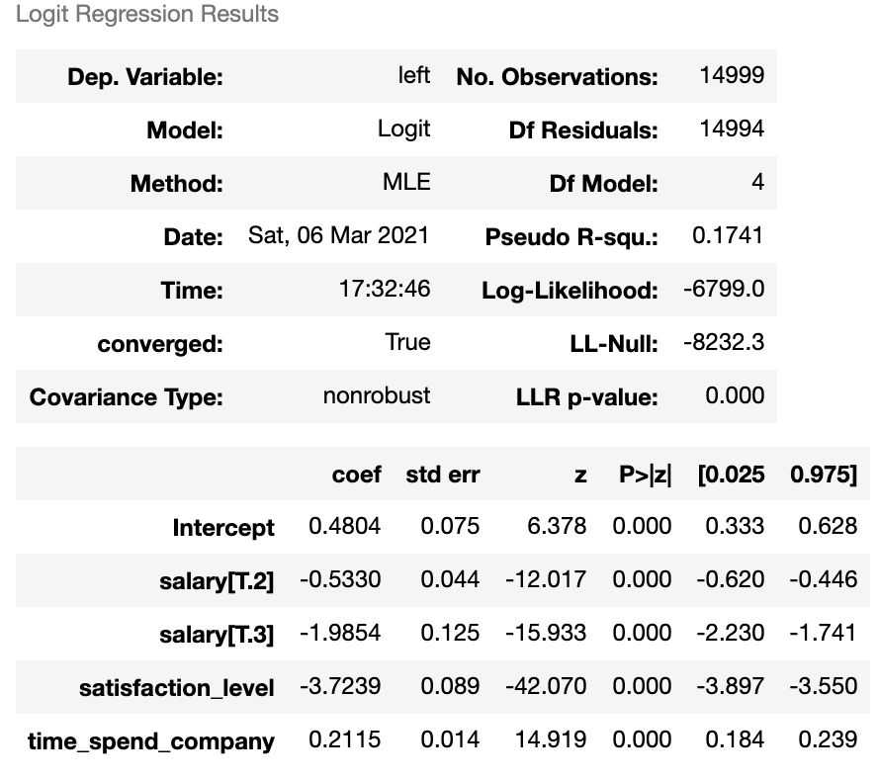
Regression Analysis, cont.

Slide 26
Regression Analysis, cont.
Since employee satisfaction has shown to have strong correlation to an employee leaving and it seems that other variables presented could lead to employee satisfaction, I wanted to look at the correlation with employee satisfaction as the dependent variable, seeing which other variables could be used to predict satisfaction.
I ran a logistic regression with satisfaction level as the dependent variable and the predictor variables salary, time with the company, promotion in the last 5 years and average hours worked.

Slide 27
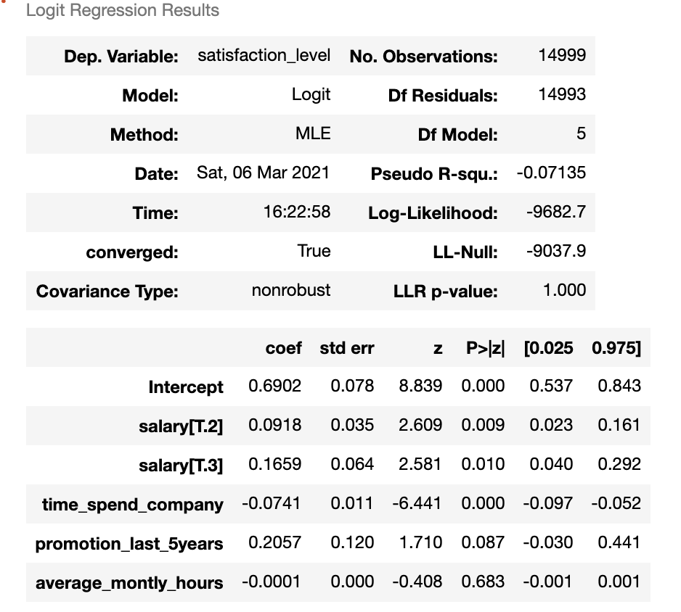
Regression Analysis, cont.

Slide 28
Regression Analysis, cont.
Based on this model, we can see that salary and time at the company have p-values near 0, which would indicate that they do have a strong correlation to employee satisfaction.
With a p-value of .087, promotion in the last five years appears that there could be a small correlation but it is not as strong as salary or time at the company and since it is over .05 would be considered insignificant.
The high p-value of .683 for average monthly hours would suggest that there is also not a strong correlation between hours and satisfaction, which would seem consistent with our plot where I could not see a correlation, however this is much different than the results from the Correlation Permutation and would require more testing.

Slide 29
Summary
In summary, I will look back at the initial questions asked and discuss findings:
Can we predict that employees will leave based on them reaching or falling below a certain satisfaction level?
Analysis: Yes, we can predict that at a satisfaction level of .4 or lower, employees will be more likely to leave and at a level of .1 or lower, leaving would be almost certain.
How do salary, promotions and monthly hours correlate to satisfaction?
Salary appears to have a strong correlation to satisfaction based on the logistic regression, promotions seemed to have an insignificant correlation, and average monthly hours appears to have a strong correlation but needs further analysis since the results of the logistic regression and correlation test had a pretty large discrepancy in the strength of this relationship.

Slide 30
Are employees with higher salary levels less likely to leave even if they have a low satisfaction level?
While I could see that it appears that highly paid employees had less instances of low satisfaction ratings, I was unable to manipulate my data to combine the salary and satisfaction level to then predict leaving. This is something I would still like to explore further.
Is there an average time with the company that employees tend to leave, and is there a length of time beyond which they are unlikely to leave even if they are not satisfied?
Yes, it was observed that we could expect employees to leave around 4-5 years. As with the previous question, I was unable to combine variables in order to do an analysis where both were true, I would like to continue looking at this.
Do certain departments experience higher turnover regardless of employee satisfaction?
Based on the department describe() statistics, I did not see any major differences in turnover or satisfaction based on department

Slide 31
References
https://www.bls.gov/news.release/pdf/tenure.pdf
https://www.kaggle.com/chandrilcg/hr-analytics-employee-turnover

